Slide 1

EFY EXPO PRESENTATION-2024
BY TEAM MEMBERS:
HARISH KUMAR A
MOHAN KUMAR D
SAISHITHA
PRADEEP S

Slide 2
TOPICS:
HARISH KUMAR A eoxys Pvt.Ltd
UNISEM
enthutech
MOHAN KUMAR D ARM software Devlopment tools
LINUMIZ - EMBEDDED SOFT
Design service in RDL technology
SAISHITHA SLA 3-d printing
Power Backup battery
i.MX 8M Mini
PRADEEP S SMTMATE ASSEMBLY LINE
SIEMENS
ROHDE & SCHWARE

Slide 3
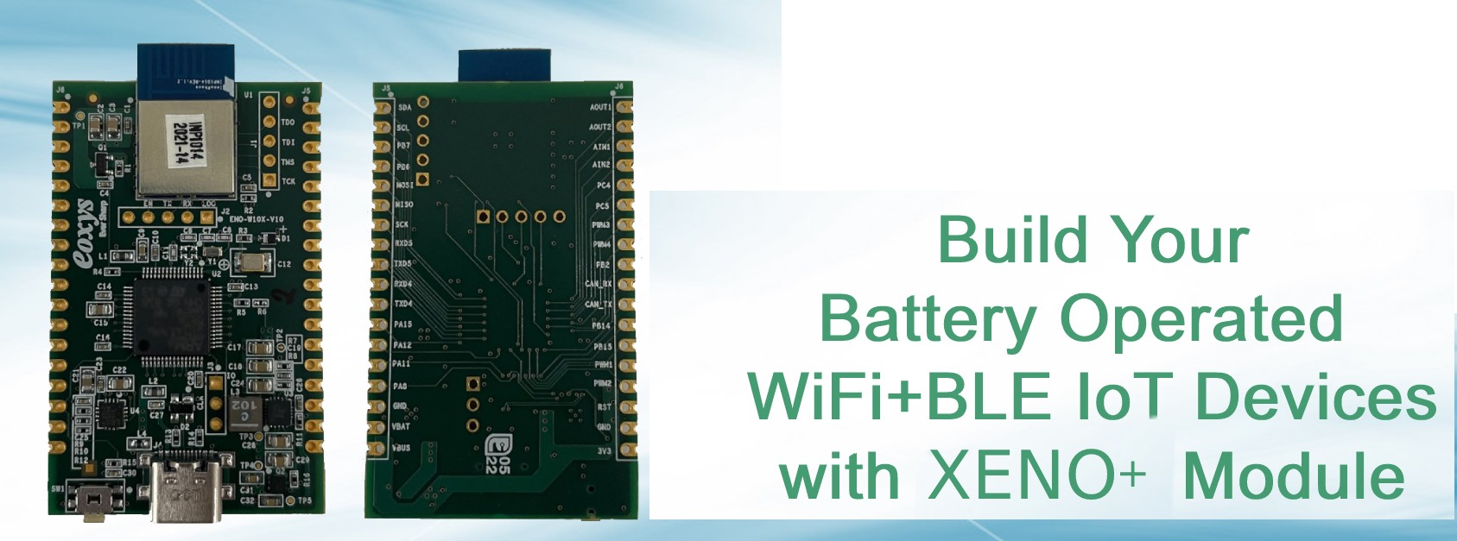
eoxys Pvt.Ltd
They are som manufacturing company and they merge wifi,bluetooth module inside the som lesser size based on customer requirements.

Slide 4
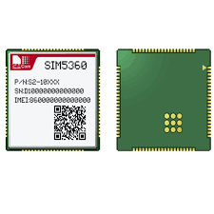
UNISEM
They are electronics components like bluetooth and wifi module creating also the main production of VLSI printed board for various purposes.

Slide 5
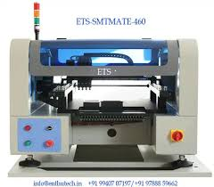
enthutech
They are create the high level board printing machine by placing the components in the board.

Slide 6
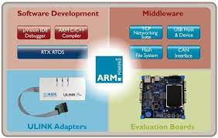
ARM software Devlopment tools
Until recently, the name Arm was treated as an acronym, ARM, which at first stood for Acorn RISC Machine and then for Advanced RISC Machine. The acronym is still widely used, although Arm Limited uses only Arm when describing its processor technology.

Slide 7

LINUMIZ - EMBEDDED SOFTWARE
Linumiz concentrates on the profound challenges facing the embedded world in industrial, commercial and other demanding markets. We focus our business service portfolio to deliver innovative solutions that bring greater value to our customers.

Slide 8
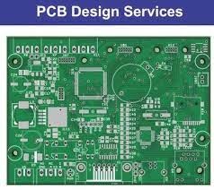
Design service in RDL technology
RDL IoT product series defines a new way of transforming factories into intelligent factories with minimum investment. internet of things - Aiming to better serve customers through greater flexibility of production and visibility of resources utilized . Improve business performance by supporting all-round optimization .

Slide 9
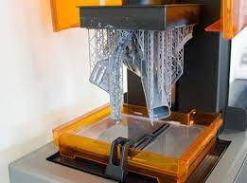
SLA 3-d printing
Stereolithography also known as vat photopolymerisation, optical fabrication, photo-solidification, or resin printing) is a form of 3D printing technology used for creating models, prototypes, patterns, and production parts

Slide 10
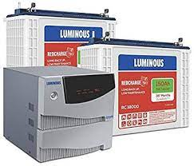
Power Backup battery
Backup batteries are used in uninterruptible power supplies (UPS), and provide power to the computers they supply for a variable period after a power failure, usually long enough to at least allow the computer to be shut down gracefully.

Slide 11
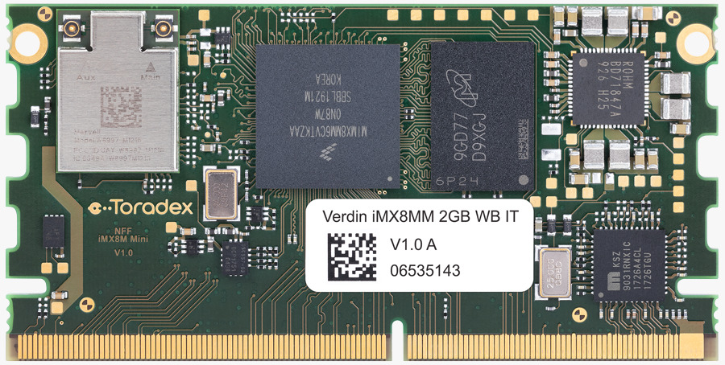
i.MX 8M Mini
Multicore Processing
4x Cortex-A53 core platforms up to 1.8GHz per core
32KB L1-I Cache/ 32 kB L1-D Cache
512 kB L2 Cache
1x Cortex-M4 core up to 400MHz
16 kB L1-I Cache/ 16 kB L2-D Cache

Slide 12
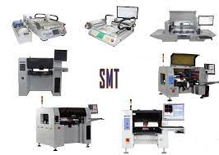
SMTMATE ASSEMBLY LINE
Surface Mount Technology (SMT) component placement systems, commonly called pick-and-place machines, are robotics machines which are used to place surface-mount devices(SMDs) onto a printed circuit board(PCB).

Slide 13
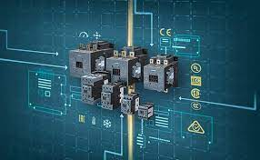
SIEMENS
Siemens Limited is a technology company focused on industry, infrastructure, digital transformation, transport as well as transmission and generation of electrical power.

Slide 14
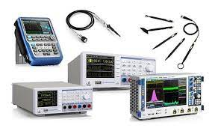
ROHDE & SCHWARZ
Rohde & Schwarz develops, produces and markets a wide range of electronic capital goods for industry, infrastructure operators and government customers.

Slide 15
THANK YOU ANY QUERIES?

